Slide 1
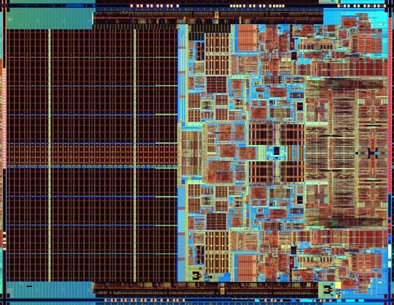
L01-<number>
Computer System Architecture
Notes:
Photo is of an Intel Conroe (Core 2 Duo Desktop processor). Photo taken from Intel web site.

Slide 2
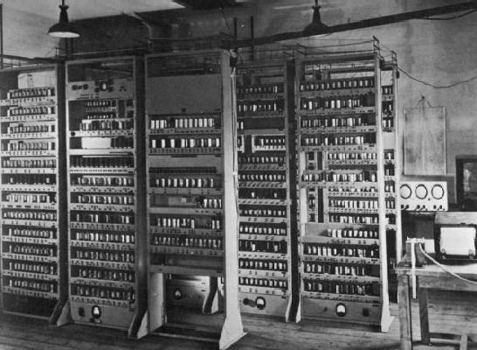
Computing Devices Then…
L01-<number>
EDSAC, University of Cambridge, UK, 1949

Slide 3
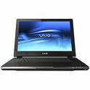


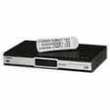
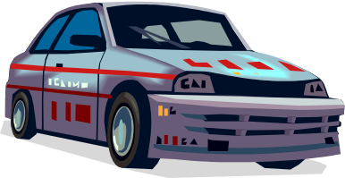
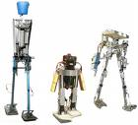
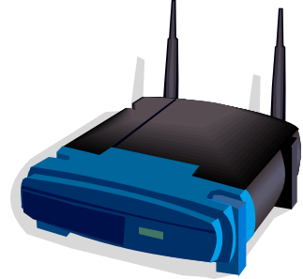
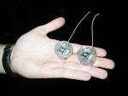

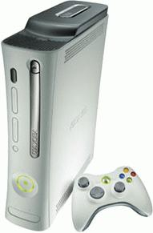


Computing Devices Now
L01-<number>

Slide 4
A journey through this space
L01-<number>
What do computer architects actually do?
Illustrate via historical examples
  Prehistory: Babbage and Analytic Engine
  Early days: Eniac, Edvac and Edsac
  Arrival of IBM 650 and then IBM 360
  Seymour Cray – CDC 6600, Cray 1
  Microprocessors and PCs
  Multicores and Cell phones
Focus on ideas and mechanisms that have withstood the test of time

Slide 5
Computer Architecture is the design of the abstraction layers
L01-<number>
Application
Algorithm
Programming Language
Parallel computing security, …
Original domain of the computer architect
(‘50s-‘80s)
Operating System/Virtual Machine
Instruction Set Architecture (ISA)
Domain of computer architecture (‘90s)
Microarchitecture
Register-Transfer Level (RTL)
Circuits
Reliability, power
Devices
Physics
Expansion of computer architecture, mid-2000s onward.

Slide 6
Importance of Technology
L01-<number>
New technologies not only provide greater
speed, size and reliability at lower cost, but
more importantly these dictate the kinds of
structures that can be considered and thus
come to shape our whole view of what a
computer is.
        Bell & Newell

Slide 7


Technology is the dominant factor in computer design
L01-<number>
Technology
  Transistors
  Integrated circuits
  VLSI (initially)
  Flash memories, …
Computers
Technology
  Core memories
  Magnetic tapes
  Disks
Computers
Technology
  ROMs, RAMs
  VLSI
  Packaging
  Low Power
Computers

Slide 8
But Software...
L01-<number>
As people write programs and use computers, our understanding of programming and program behavior improves.
  This has profound though slower impact on computer architecture
Modern architects cannot avoid paying attention to software and compilation issues.
Technology
Computers
Software

Slide 9
Architecture is Engineering Design under constraints
L01-<number>
Factors to consider:
Performance of whole system on target applications
  Average case & worst case
Cost of manufacturing chips and supporting system
Power to run system
  Peak power & energy per operation
Reliability of system
  Soft errors & hard errors
Cost to design chips (engineers, computers, CAD tools)
  Becoming a limiting factor in many situations, fewer unique chips can be justified
Cost to develop applications and system software
  Often the dominant constraint for any programmable device
At different points in history, and for different applications at the same point in time, the relative balance of these factors can result in widely varying architectural choices

Slide 10
The course has 5 modules
L01-<number>
Module 1
  Instruction Set Architecture (ISA)
  Simple Pipelining and Hazards
  Microprogramming
Module 2
  Caches
  Virtual Memory
Module 3
  Complex Pipelining and Reorder Buffer
  Branch Prediction and Speculative Execution
Module 4
  Symmetric Multiprocessors (SMPs)
  Memory Models
  Cache Coherence Protocols
  Synchronization
Module 5
  Vector machines
  VLIW, EPIC
  Multithreading
  Virtual machines

Slide 11
L01-<number>
Prehistory:
Charles Babbage & Ada Byron

Slide 12
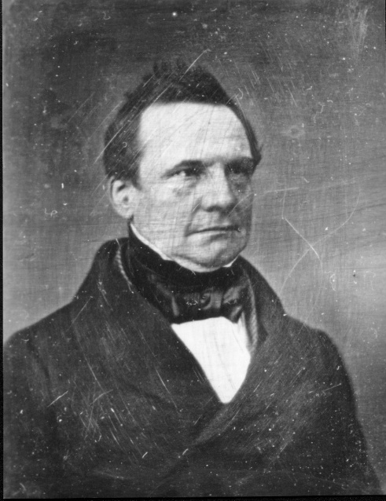
Charles Babbage 1791-1871
Lucasian Professor of Mathematics,
Cambridge University, 1827-1839
L01-<number>

Slide 13
Charles Babbage
L01-<number>
Difference Engine 1823
Analytic Engine 1833
  The forerunner of modern digital computer!
Application
  Mathematical Tables – Astronomy
  Nautical Tables – Navy
Background
  Any continuous function can be approximated by a polynomial --- Weierstrass
Technology
  mechanical - gears, Jacquard’s loom, simple calculators

Slide 14
Difference Engine
A machine to compute mathematical tables
L01-<number>
Weierstrass:
  Any continuous function can be approximated by a polynomial
  Any Polynomial can be computed from difference tables
An example
    f(n) = n²+n+41
    d1(n) = f(n) - f(n-1) = 2n
    d2(n) = d1(n) - d1(n-1) = 2
    f(n) = f(n-1) + d1(n) = f(n-1) + (d1(n-1) + 2)
  n 0 1 2 3 4 ...
  d2(n) 2 2 2
  d1(n) 2 4
  f(n) 41 43 47
6
8
53
61
all you need is an adder!

Slide 15
Difference Engine
L01-<number>
1823
  Babbage’s paper is published
1834
  The paper is read by Scheutz & his son in Sweden
1842
  Babbage gives up the idea of building it;he is onto Analytic Engine!
1855
  Scheutz displays his machine at the Paris World Fare
  Can compute any 6th degree polynomial
  Speed: 33 to 44 32-digit numbers per minute!
- Now the machine is at the Smithsonian.
- Also a working replica of Difference Engine-2 is on display at the computer museum in Mountainview CA

Slide 16
Analytic Engine
L01-<number>
1833: Babbage’s paper was published
  conceived during a hiatus in the development of the difference engine
Inspiration: Jacquard Looms
  looms were controlled by punched cards
    The set of cards with fixed punched holes dictated the pattern of weave ⇒ program
    The same set of cards could be used with different colored threads ⇒ numbers
1871: Babbage dies
  The machine remains unrealized.
It is not clear if the analytic engine could be built even today using only mechanical technology

Slide 17
Analytic Engine
The first conception of a general purpose computer
L01-<number>
The store in which all variables to be operated upon, as well as all those quantities which have arisen from the results of the operations are placed.
The mill into which the quantities about to be operated upon are always brought.
The program
Operation variable1 variable2 variable3
An operation in the mill required feeding two punched cards and producing a new punched card for the store.
An operation to alter the sequence was also provided!

Slide 18
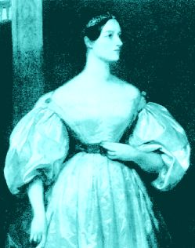
The first programmer
Ada Byron aka “Lady Lovelace” 1815-52
L01-<number>
Ada’s tutor was Babbage himself!

Slide 19
Babbage’s Influence
L01-<number>
Babbage’s ideas had great influence later primarily because of
  Luigi Menabrea, who published notes of Babbage’s lectures in Italy
  Lady Lovelace, who translated Menabrea’s notes in English and thoroughly expanded them.
    “... Analytic Engine weaves algebraic patterns....”
In the early twentieth century - the focus shifted to analog computers but
  Harvard Mark I built in 1944 is very close in spirit to the Analytic Engine.

Slide 20
Harvard Mark I
L01-<number>
Built in 1944 in IBM Endicott laboratories
  Howard Aiken – Professor of Physics at Harvard
  Essentially mechanical but had some electro-magnetically controlled relays and gears
  Weighed 5 tons and had 750,000 components
  A synchronizing clock that beat every 0.015 seconds
Performance:
0.3 seconds for addition
6 seconds for multiplication
1 minute for a sine calculation
Broke down once a week!

Slide 21
L01-<number>
Early Developments:
From Eniac to IBM 701

Slide 22

Electronic Numerical Integrator and Computer (ENIAC)
L01-<number>
Designed and built by Eckert and Mauchly at the University of Pennsylvania during 1943-45
The first, completely electronic, operational, general-purpose analytical calculator!
  30 tons, 72 square meters, 200KW
Performance
  Read in 120 cards per minute
  Addition took 200 μs, Division 6 ms
  1000 times faster than Mark I
Not very reliable!
WW-2 Effort
Application: Ballistic calculations
angle = f (location, tail wind, cross wind,
air density, temperature, weight of shell,
propellant charge, ... )
Notes:
Designers were obliged to install a ventilation shaft and a cooling system in the room. Machine had 18,000 vacuum tubes.
The slogan was: The ENIAC is able to calculate the trajectory of a large-caliber naval shell in less time than the shell takes to reach its target!
To change a program, it was necessary to change the instructions, the connector panels, and the positions of the switches all at the same time.
The inventors of ENIAC themselves admitted that, after taking into account human error, the machine only got the correct result 20 times out of 100!

Slide 23
Electronic Discrete Variable Automatic Computer (EDVAC)
L01-<number>
ENIAC’s programming system was external
  Sequences of instructions were executed independently of the results of the calculation
  Human intervention required to take instructions “out of order”
EDVAC was designed by Eckert, Mauchly and von Neumann in 1944 to solve this problem
  Solution was the stored program computer
  ⇒ “program can be manipulated as data”
First Draft of a report on EDVAC was published in 1945, but just had von Neumann’s signature!
  Without a doubt the most influential paper in computer architecture
Notes:
Von Neumann (1903-1957) was born in Budapest. Great quantities of work in set theory to quantum physics. Celebrated for his theory of games and its application to economics.
Report was the formal specification of EDVAC. Before that the documentation on ENIAC or EDVAC was non-existent. Von Neumann devised a mathematical logical notation which expressed fundamental ideas of the fetch-execute-decode loop.
Five major components: Arithmetic unit, control unit, the memory, input devices and output devices.

Slide 24
Stored Program Computer
L01-<number>
Program = A sequence of instructions
How to control instruction sequencing?
manual control calculators
automatic control
  external ( paper tape) Harvard Mark I , 1944
Zuse’s Z1, WW2
  internal
    plug board ENIAC 1946
    read-only memory ENIAC 1948
    read-write memory EDVAC 1947 (concept )
                          The same storage can be used to store program and data
EDSAC 1950 Maurice Wilkes

Slide 25
The Spread of Ideas
L01-<number>
ENIAC & EDVAC had immediate impact
brilliant engineering: Eckert & Mauchley
lucid paper: Burks, Goldstein & von Neumann
  IAS Princeton 46-52 Bigelow
  EDSAC Cambridge 46-50 Wilkes
  MANIAC Los Alamos 49-52 Metropolis
  JOHNIAC Rand 50-53
  ILLIAC Illinois 49-52
        Argonne 49-53
  SWAC UCLA-NBS
UNIVAC - the first commercial computer, 1951
Alan Turing’s direct influence on these developments
is often debated by historians.

Slide 26
Dominant Technology Issue: Reliability
L01-<number>
ENIAC ⇒ EDVAC
18,000 tubes 4,000 tubes
20 10-digit numbers 2000 word storage
mercury delay lines
Mean time between failures (MTBF)
  MIT’s Whirlwind with an MTBF of 20 min. was perhaps the most reliable machine !
Reasons for unreliability:
1. Vacuum Tubes
2. Storage medium
  acoustic delay lines
  mercury delay lines
  Williams tubes
  Selections
CORE J. Forrester 1954

Slide 27
BINAC
L01-<number>
Two processors that checked each other
for reliability.
  Didn’t work well because processors never
  agreed

Slide 28
And then there was IBM 701
L01-<number>
IBM 701 -- 30 machines were sold in 1953-54
IBM 650 -- a cheaper, drum based machine,
more than 120 were sold in 1954
and there were orders for 750 more!
Users stopped building their own machines.
Why was IBM late getting into computers?
IBM was making too much money!
    Even without computers, IBM revenues were doubling every 4 to 5 years in 40’s and 50’s.

Slide 29
Software Developments
L01-<number>
up to 1955 Libraries of numerical routines
        - Floating point operations
        - Transcendental functions
        - Matrix manipulation, equation solvers, . . .
1955-60 High level Languages - Fortran 1956
        Operating Systems -
        - Assemblers, Loaders, Linkers, Compilers
        - Accounting programs to keep track of
        usage and charges
Machines required experienced operators
⇒ Most users could not be expected to understand
these programs, much less write them
  ⇒ Machines had to be sold with a lot of resident
    software

Slide 30
Commercial Activity: 1948-52
L01-<number>
IBM’s SSEC
  Selective Sequence Electronic Calculator
  150 word store.
  Instructions, constraints, and tables of data were read from paper tapes.
  66 Tape reading stations!
  Tapes could be glued together to form a loop!
  Data could be output in one phase of computation and read in the next phase of computation.

Slide 31
Linear Equation Solver
John Atanasoff, Iowa State University
L01-<number>
1930’s:
  Atanasoff built the Linear Equation Solver.
  It had 300 tubes!
Application:
  Linear and Integral differential equations
Background:
  Vannevar Bush’s Differential Analyzer
  --- an analog computer
Technology:
  Tubes and Electromechanical relays
Atanasoff decided that the correct mode of computation was by electronic digital means.

